Slide 1
THANK YOU FOR DOWNLOADING! HOPE IT HELPS YOU WITH YOUR PRESENTATIONS!
In case the embedded fonts don’t work, here are the download links:
Playfair Display
https://fonts.google.com/specimen/Playfair+Display?query=playfair&category=Serif&preview.text=How%20you%20like%20that%3F&preview.text_type=custom
Mazama
https://fontsgeek.com/fonts/Mazama-Regular
@dstoryco
www.dstory.co

Slide 2


Slide 3

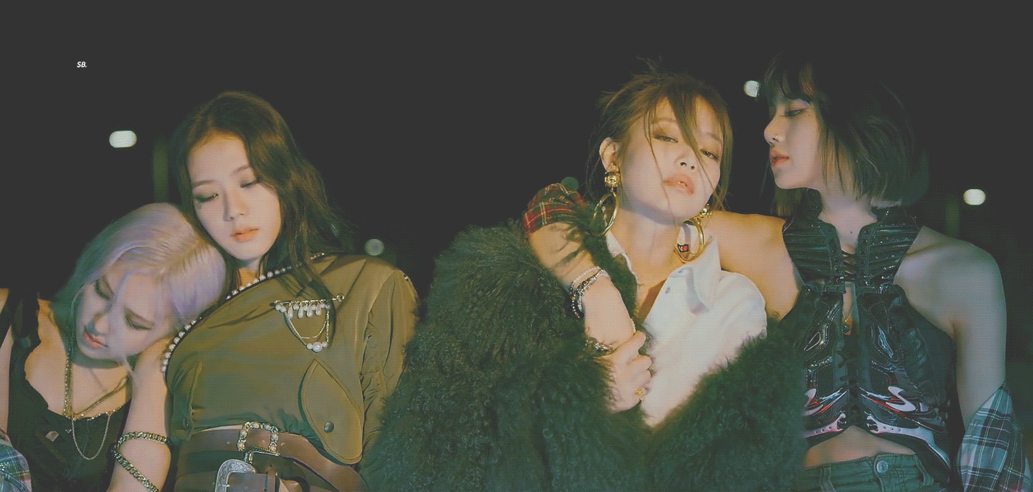

Lovesick Girls
HOW TO GET OVER A HEARTBREAK
A GUIDE FOR
august 24th 2022
@dstoryco

Slide 4
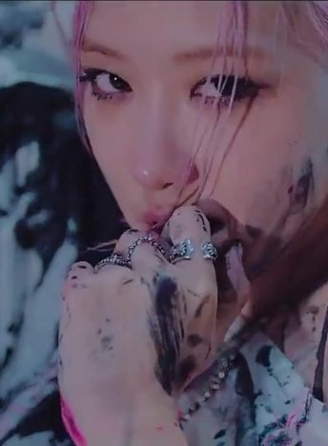
CONTENTS
Chapter.01
Stages of a breakup
Chapter.02
How long to get over a breakup
Chapter.03
How to get over a breakup
Chapter.04
Remember who you are

Slide 5






Shock
Demand
Bargaining
Anger
Sadness + Grief
Acceptance
Moving on
STAGES OF BREAKUP
Notes:
Ink splatters from Freepik.com

Slide 6


Chapter.02

Slide 7
the breakup equation
x
—
= y
x = time you’ve dated
y = time to get over
2

Slide 8



NO CONTACT RULE
What are you up to?
Don’t text them
Where are you?
Did you eat?
Goodnight
Baby
Darling
Honey
I miss you

Slide 9

HOW TO GET OVER A HEARTBREAK
Chapter
04

Slide 10
YOU ARE HERE
Pretty
Savage
I thought that you’d remember,
but it seems that you forgot.

